Slide 1
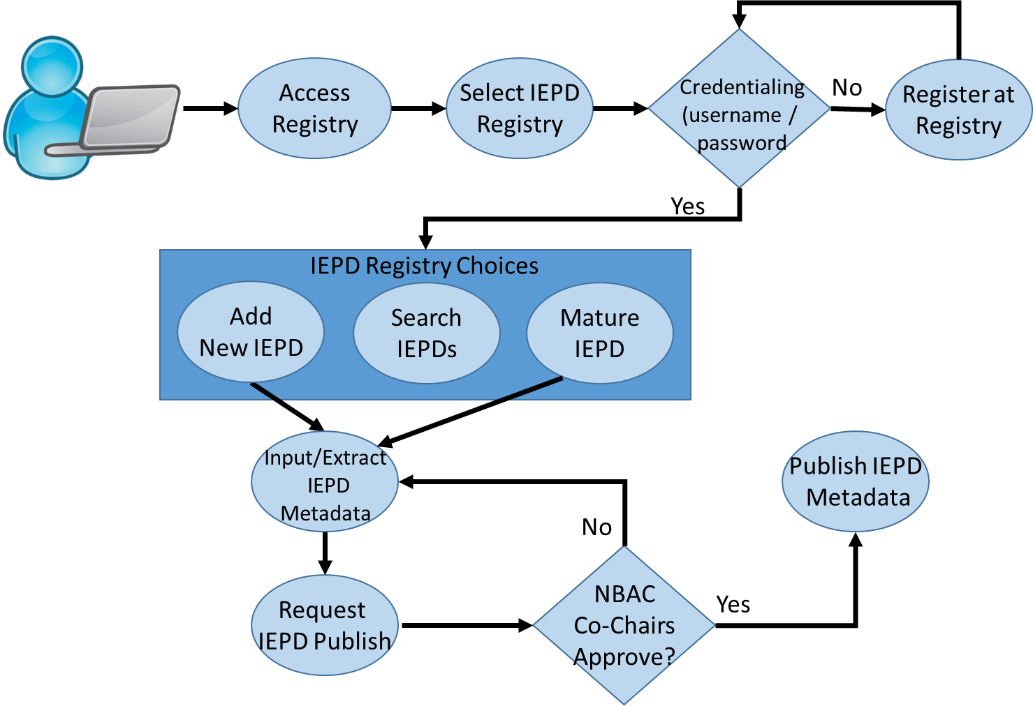
NIEM IEPD Discovery Registry Concept
*
*

